Slide 1
Info Session
2021-2022
Google Developer Student Clubs
Amity University Lucknow

Slide 2
What’s a GDSC?
Google Developer Student Clubs
They are an initiative taken by Google. To create student communities on campus for university and college students built around love for technology, innovation, and problem-solving.

Slide 3
Who can join a GDSC?
??
Any student interested in Google or non-Google technology can join.
No restrictions of course, stream, background etc.
Only willingness to learn and contribute is required.

Slide 4
Objectives of GDSC
Our goals
To solve real world problems.
To explore and learn new technologies.
To bridge the gap between theory and practice.
To establish a peer-to-peer based learning environment.
To help students expand their professional network.

Slide 5
Our tagline
Connect
Learn
Grow

Slide 6
How we plan to achieve those objectives.
Holding workshops, seminars and talks about various technologies.
Holding hackathons, ideathons, and various contests.
Inviting guest speakers and google community experts to give talks at our events.
Holding fun and interactive events in collaboration with other universities.

Slide 7
Going on field trips to explore and understand the problems of local businesses and then try to build a solution for them.

Slide 8
What will students gain?
Grow their knowledge in a peer-to-peer learning environment.
Build solutions for local businesses and their communities.
Learn how to work in a team.
Opportunity to collaborate with other developers all over the world.

Slide 9
Exclusive Benefits
Get to participate in exclusive Google events like 30 Days of GCP, Solution Challenge etc.
Get a chance win awesome prizes and goodies.
Earn exclusive badges on their Google Developer Profiles.
Get official certifications if they perform well at events.

Slide 10
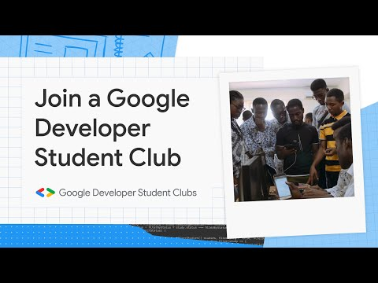

Slide 11
Meet the Leads!
2021-2022
Google Developer Student Clubs
Amity University Lucknow

Slide 12
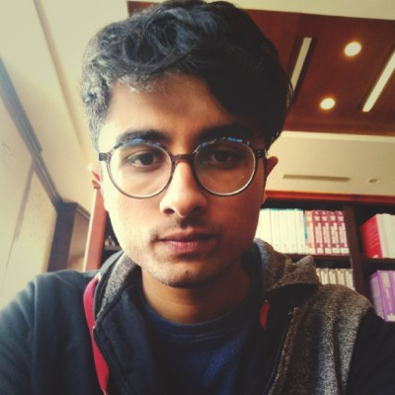
Tech Lead
Full Stack Developer
Ali Zaidi
aali#3107
(Discord handle)

Slide 13
Responsibilities
Tech Lead
Oversee all technical departments in GDSC.
Work with the GDSC lead to make sure that the club is active, and events such as workshops, seminars etc. are held frequently for students to benefit from.
Try my best to be approachable and resolve any queries students may have or atleast guide them to the right people and resources.
Oversee all technical events.

Slide 14
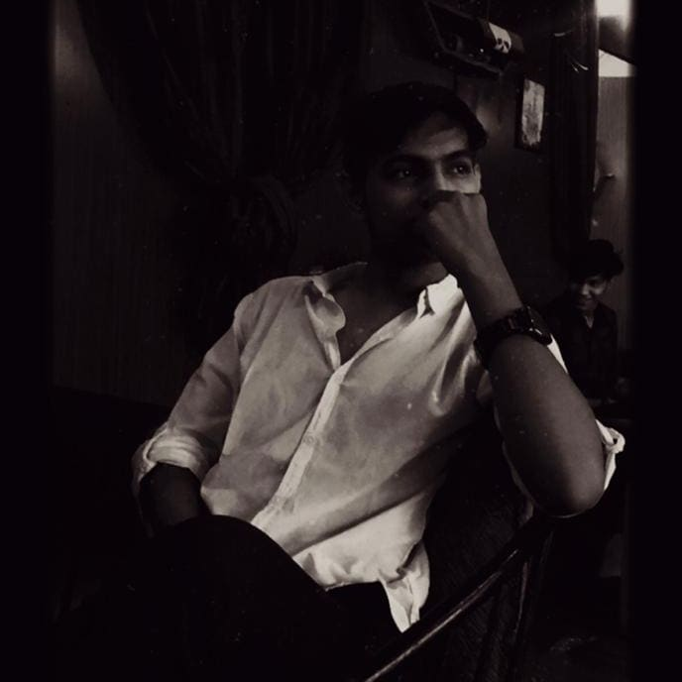
Management Lead
The human task scheduler.
Nishant Jaiswal
@jaiswalnj075
(INSTAGRAM & TWITTER HANDLE)

Slide 15
“A key to achieving success is to assemble a strong and stable management team.”
I am Nishant Jaiswal,Management Lead in GDSC- Amity University, Lucknow. I am a 2nd year B.tech CSE student.
I am very grateful to be a part of the Google Developer Student Clubs. Also very excited to share my knowledge and help other to grow up as developers through this platform where i can deliver quality and meaningful value to the club.

Slide 16
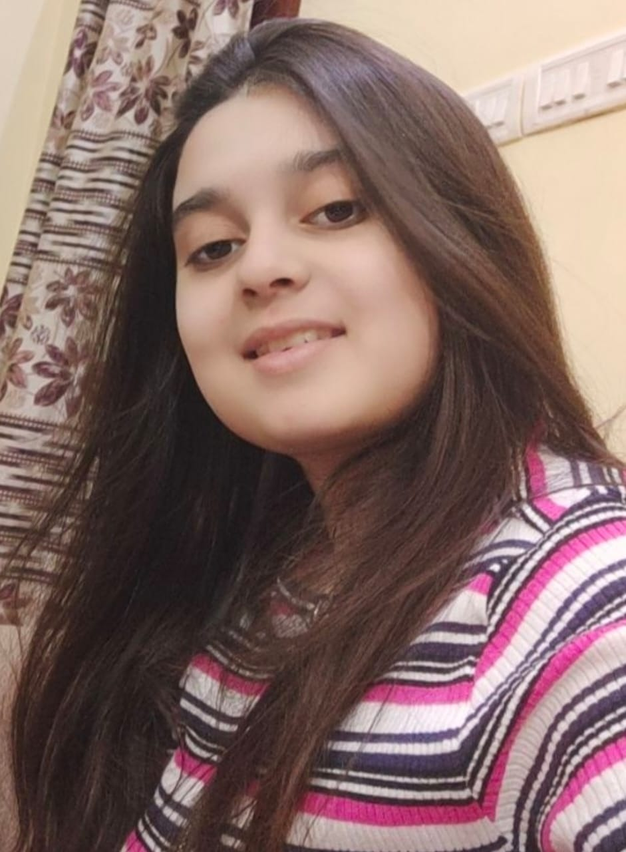
Public Relations Lead
https://www.linkedin.com/in/adiba-khan-2000cse/
@adiba-cse
Github

Slide 17
Hey there!,I am Adiba Khan Public Relations Lead of Amity University,Lucknow Campus.I am a student of B.Tech Computer Science and Engineering 3rd year.
Currently I am interning at Coding Ninjas as “Ninja Entrepreneur”and I am the Campus Facilitator of “30 Days of Google Cloud Program” of Amity University,Lucknow Campus.
I am really very excited to take the responsibility of Public Relations Lead of Amity University,Lucknow Campus.I love connecting with people ,getting their popular opinion and solving their problems.

Slide 18
RESPONSIBILITY:
Public Relations Lead’s office comes with great responsibilities. As Public Relations Lead ,I would be:
Responsible for maintaining the public image of the Club.
Representing the club at different occasions.
Responsible for finding Sponsors and Speakers.

Slide 19
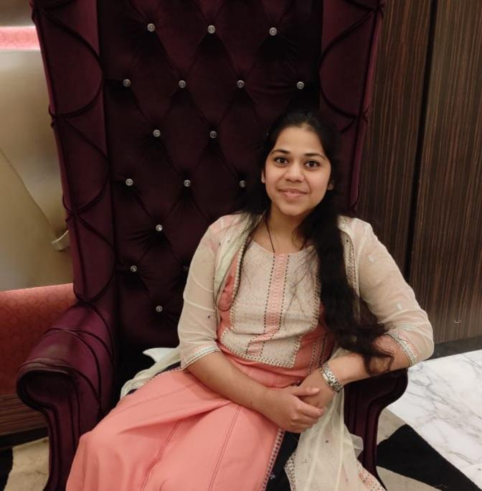
Media & Outreach Lead
Juhi Dwivedi
https://www.linkedin.com/in/juhi-dwivedi (LinkedIn ID)

Slide 20
Heya Everyone! I am Juhi Dwivedi, B.Tech. CSE (1st Year) student at Amity University. I am the Media & Outreach Lead for GDSC.
I will be responsible for the social media presence of our group.
We live in an age where we get to use Social Media as a tool. I am a fresher, so obviously, my exposure has been limited, but despite that I have heard great things about this society.
Just imagine how many more people we can reach and influence if our club gets the deserved recognition on all social media platforms. I need the support of all of our members to help our club reach great heights. I look forward to connecting with you all! “ If You Want To Go Fast, Go Alone. If You Want To Go Far, Go Together” Cheers To Growing Together!

Slide 21
Responsibilities
Media & Outreach Lead
The role of the Media & Outreach Lead comes with various responsibilities. Few of them have been mentioned below:-
Strengthening Relationships between the Organization and Community
Organizing Outreach Campaigns
Maintaining the Social Image of the Organization
Creating/Designing Promotional Content For Target Audience
Serving as the Communicating Link between the Organization and Community
Building Strong Online Communities
Engaging Users Authentically on Social Media

Slide 22
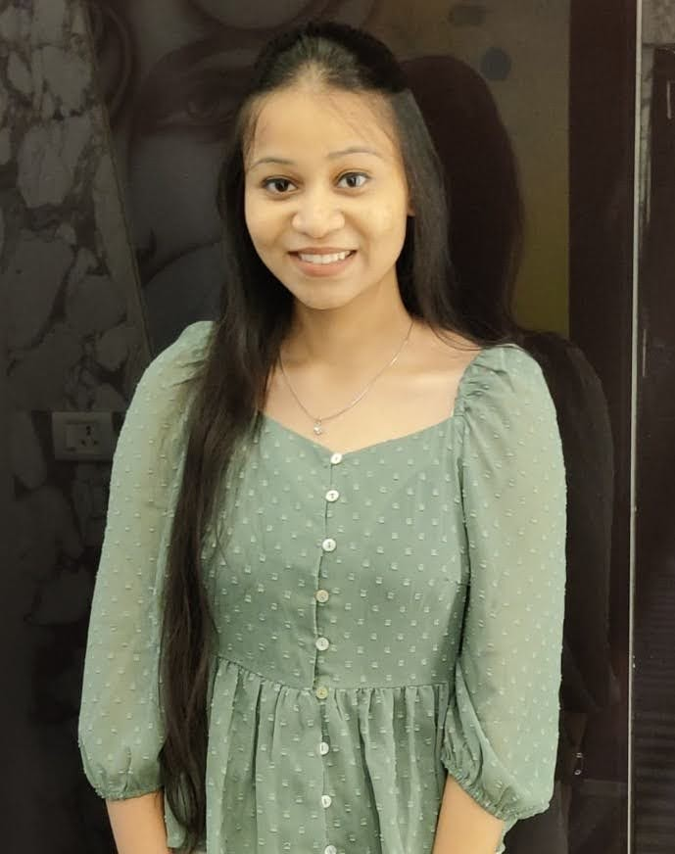
Gender Diversity Lead
.
Saumya Srivastava
@iamsaumya02
(INSTAGRAM HANDLE)

Slide 23
I am Saumya Srivastava, Gender Diversity Lead in GDSC- Amity University, Lucknow. I am 2nd year Btech CSE student.
As much I have observed ratio of male in technical field is more than females so my focus as a lead will be to motivate more girls to contribute to technical field. Now a days we are seeing a lot of startups coming up in India but mostly they are driven by males, so I’ll to encourage girls to be part of startup ecosystem and come up with more ideas.
I’m still a fresher when it comes to technical world, but I’ll study more about it so that I can help and encourage more students to take part in it.

Slide 24
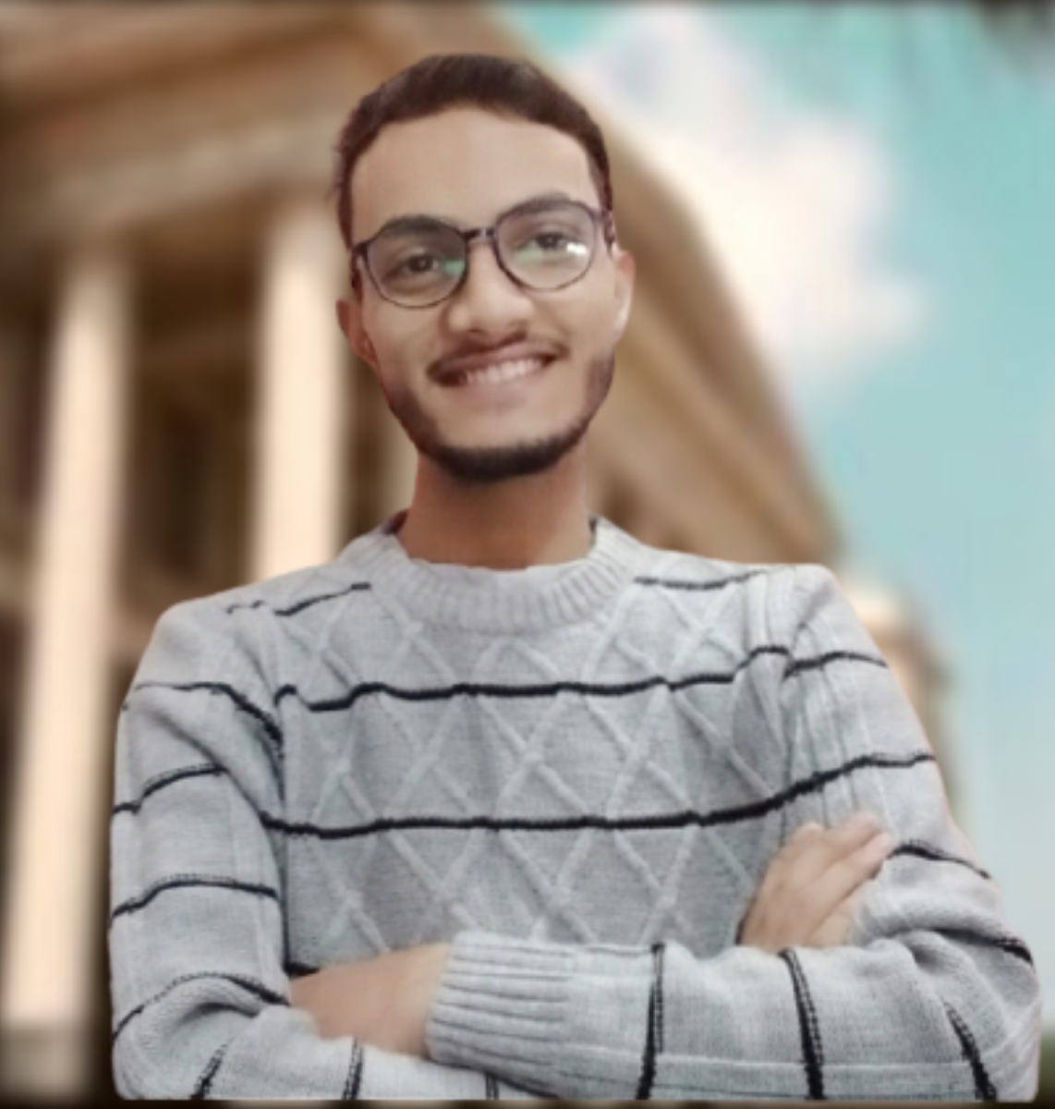
Content-creation Lead
Syed Ali Jibran Rizvi
@ali_jibran_rizvi
(INSTAGRAM HANDLE)

Slide 25
I am Syed Ali Jibran Rizvi, the newly appointed content-creation Lead in GDSC-Amity University, Lucknow.
I am a Btech CSE student, a fresher at this University.
I heard great things about the Google Developer Student Clubs during my schooling days. So, my main focus was to join the club and enjoy working as a team. I always love being tech-savvy, creative, intuitive, sensitive, articulate, and a responsible guy, which is why I am elated to take the responsibilities on my shoulder.
I am open to every content-related matter. It will indeed be an honor for me to work with the collaborative and conscientious core team.
"Alone, we can whistle a symphony, but, together as a team, we can play a whole orchestra."

Slide 26
RESPONSIBILITY:
As the Content Lead, I will always:
Strive to create professional and error-free documentation to establish credibility with the audience.
Analyze the target audience to get the idea of the tone and knowledge level of the document, to tailor it specifically.

Slide 27
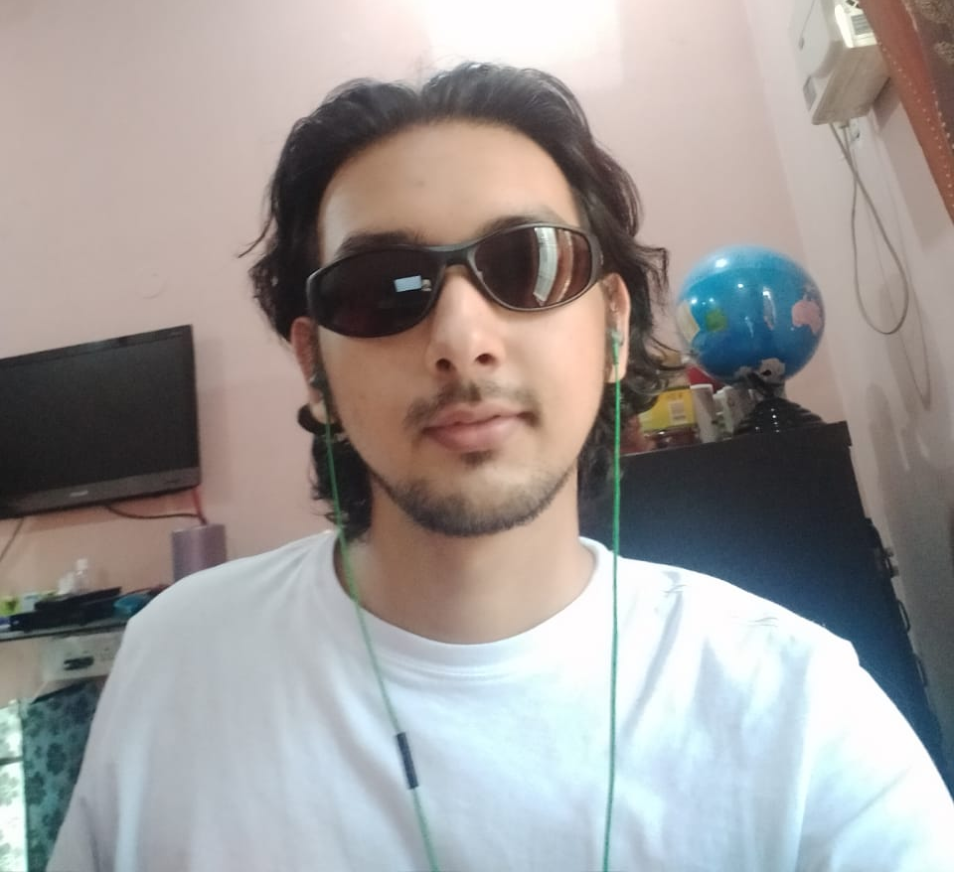
Web Lead
Full Stack Developer
Tauseef Ahmad
chlorine#2926
(Discord handle)

Slide 28
Responsibilities
Web Lead
Organise workshops and bootcamps related to web dev and software development.
Try my best to be approachable and resolve any queries students may have or atleast guide them to the right people and resources.
Help students build good projects.

Slide 29
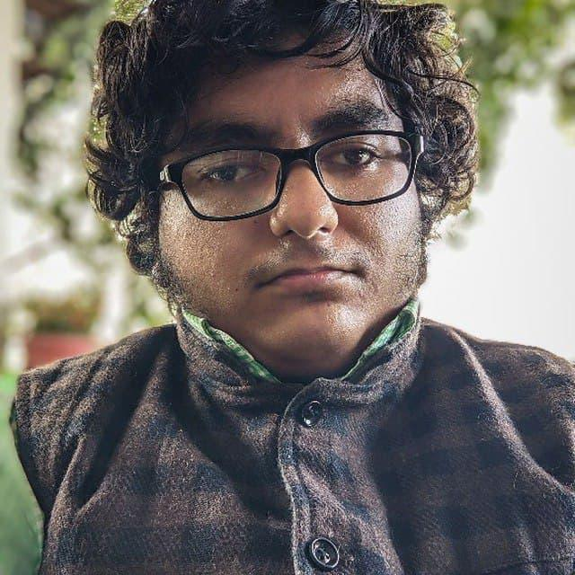
Android Lead
Can merge fwb
Venkatesh Chaturvedi
@V3NK4135H
(Telegram Username)

Slide 30
I am Venkatesh Chaturvedi, the Android Lead in GDSC-Amity University, Lucknow.
I am a 3rd CSE student at this University.
I am very grateful to be a part of the Google Developer Student Clubs. I have always been amazed by the Android operating system. That is why I am currently working on a customized fork of the Android Open Source Project (AOSP).
I am open to any kind of queries related to Android and will try my best to solve them. It will indeed be an honor for me to work with this team.

Slide 31
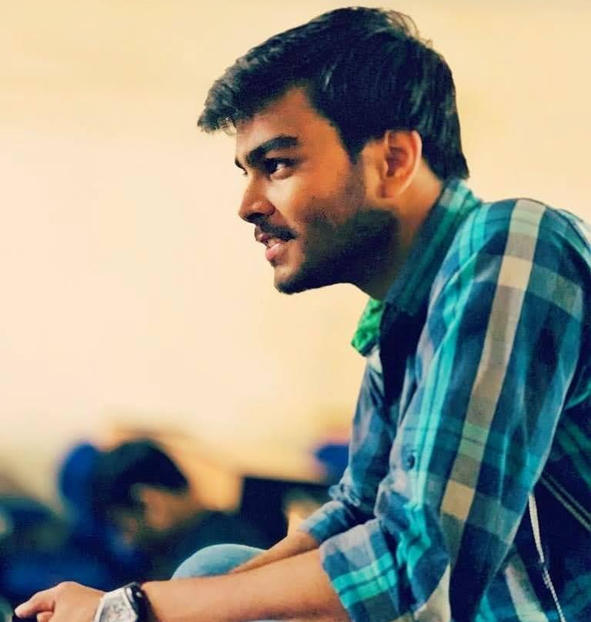
Cloud Lead
DevOps/AWS
Subhanshu Mohan Gupta
@subhanshugupta0@gmail.com
(E-Mail ID)

Slide 32
Myself Subhanshu Mohan Gupta {
// deploying applications and exploring various DevOps tools in cloud
int semester = 5;
char x[100] = “currently pursuing BTech(CSE) from Amity University Lucknow”;
printf(“%d \n%s”, semester, x);
printf(“\nI’m a Cloud Lead in GDSC-Amity University Lucknow & I’m very delighted to be a
part in this community”);
printf(“\nSince my 4th semester, I’ve always been driven to pursue this field as my career
because it is an exciting and fulfilling field as cloud engineers get to solve
real-world problems that affect people around the world & on top of that cloud
computing involves creative and varied skills that branch off of software
development”);
printf(“\nIf you’ve any queries related to this field then you know whom to ask about it”);
}

Slide 33
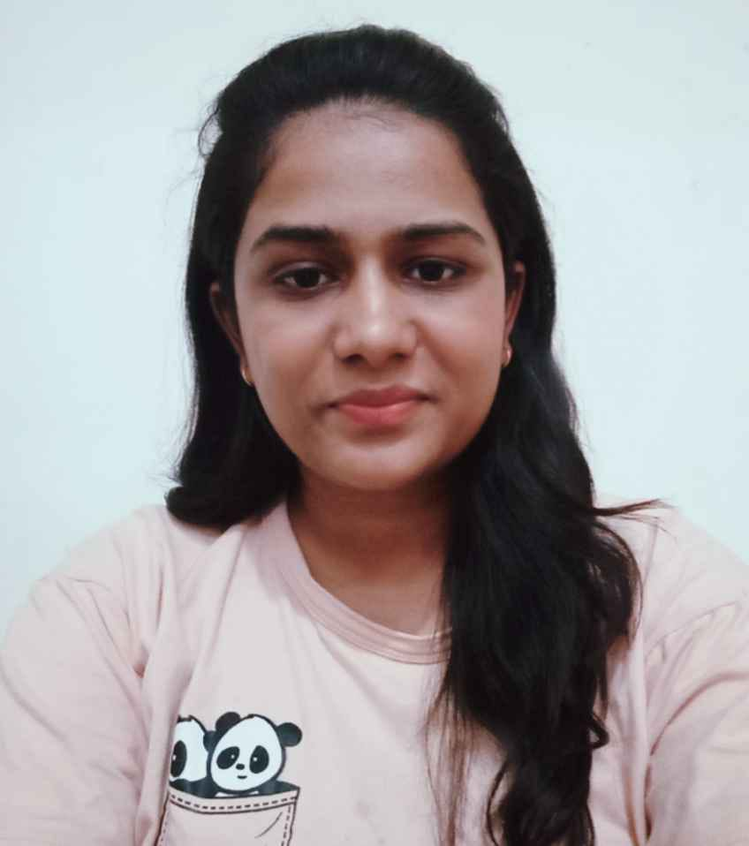
Data Science Lead
.
Radha Agrawal
@Radha919
Telegram username

Slide 34
I am Radha Agrawal currently in 3rd year CSE student in Amity University, Lucknow.
I am a Data Science Lead in GDSC, Amity Lucknow.
I am really very excited to be a part of this club and given an opportunity in my interested field. Currently, I am working as an intern in Data Science.
I am still exploring more in this field but the knowledge that I have gain till now, I want to share with you people so that you can be able to start in field of Data Science. And I am thankful to GDSC where I can learn more.

Slide 35
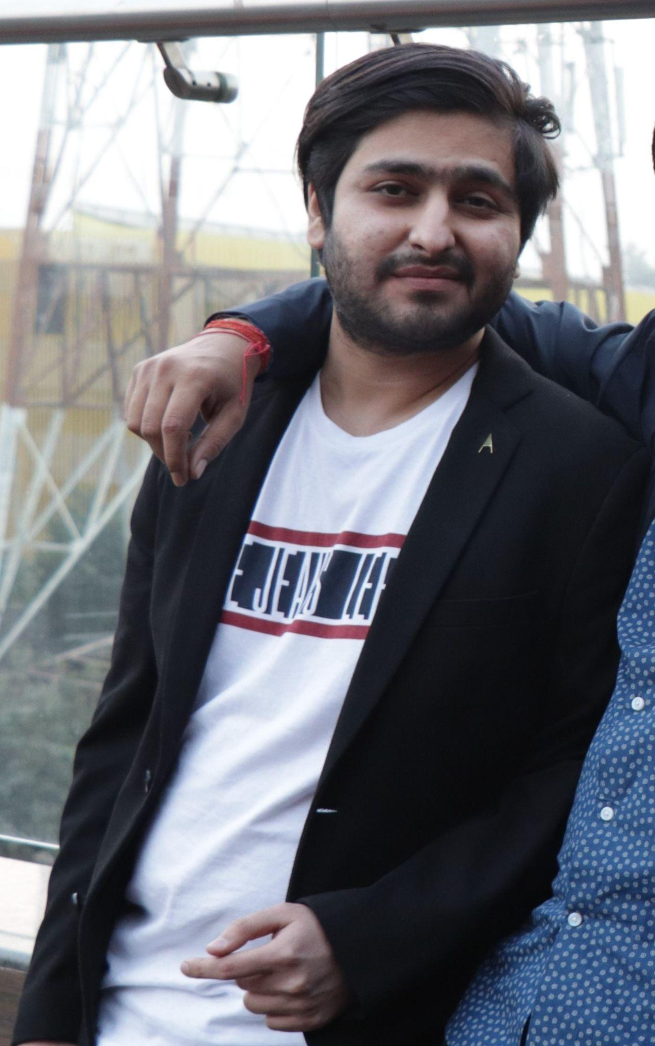
Machine Learning / Artificial Intelligence Lead
Mohit Sethi
@m.sethi006@gmail.com
(E-mail ID)

Slide 36
Power is gained by sharing knowledge, not hoarding it.

Slide 37
Address by our Faculty
Advisor
Dr. Bramah Hazela
Assistant Professor
Amity University Lucknow

Slide 38
Session with Guest Speakers
Tauseef Ahmad (B.Tech(CSE) 4th year)
Neelesh Singh (B.Tech.(CSE) 4th year)
Harsh Malra (B.Tech.(CSE) 4th year)

Slide 39
Questions?
Google Developer Student Clubs
Amity University Lucknow

Slide 40
Connect with us:
Become an official member:
https://gdsc.community.dev/amity-university-lucknow/
Discord: https://discord.gg/YC7qp3K7Ts

